Slide 1

CAPSTONE PROJECT
SECURE DATA HIDING IN IMAGE USING STEGANOGRAPHY
Presented By :
ALWIN ROSHAN I
RAJALAKSHMI INSTITUTE OF TECHNOLOGY,
B.E. Computer & Communication Engineering

Slide 2
OUTLINE
Problem Statement
Technology used
Wow factor
End users
Result
Conclusion
Git-hub Link
Future scope

Slide 3
Problem Statement
In today's digital world, securely hiding sensitive information is a challenge. This project provides a Simple and effective steganography tool that allows users to hide a secret message inside an image. It ensures privacy and security while keeping the process user-friendly with a graphical interface.

Slide 4
Technology used
Programming Language - Python
Libraries and Frameworks -
Image Processing: OpenCV (cv2), NumPy (numpy)
GUI Development: PyQt5
File Handling: OS Module
Text Processing: re Module (Regular Expressions)
Build and Packaging Tools - PyInstaller, Inno Setup, GitHub Actions
Version Control - Git, GitHub
Documentation - Markdown (README.md)
Operating System Compatibility - Windows (Primary), Cross-Platform Potential (macOS, Linux)
Ethical and Legal Considerations - Disclaimer for Ethical Use

Slide 5
Wow factors
WOW Factors of the Steganography Tool
🚀 Multi-File Hiding Capability
Can embed multiple files inside an image while keeping the image visually unchanged.
🎨 User-Friendly GUI
Built with PyQt5, making it easy for non-technical users to use steganography effortlessly.
🖼️ Drag-and-Drop Support
Allows users to simply drag and drop files for easy encryption and decryption.
⚡ Standalone Executable
Provides both a Portable Version (no installation needed) and a Setup Version (for easy installation).
🛠️ Cross-Platform Compatibility
Can be adapted to Linux and macOS, increasing usability across multiple operating systems.
🔍 Fast and Efficient Processing
Uses OpenCV and NumPy for optimized image handling and fast data embedding/extraction.
🔐 Secure and Ethical Usage
Encourages ethical use of steganography, making it a valuable tool for privacy-conscious users.

Slide 6
End users
This Image Steganography project can be useful for various types of users, including:
🔹 Cybersecurity Enthusiasts – To learn about data hiding techniques.
🔹 Privacy-Conscious Users – To securely store sensitive messages in images.
🔹 Hackers & Ethical Hackers – To understand steganography techniques for forensic analysis.
🔹 Students & Researchers – For academic projects and research in cryptography and steganography.

Slide 7
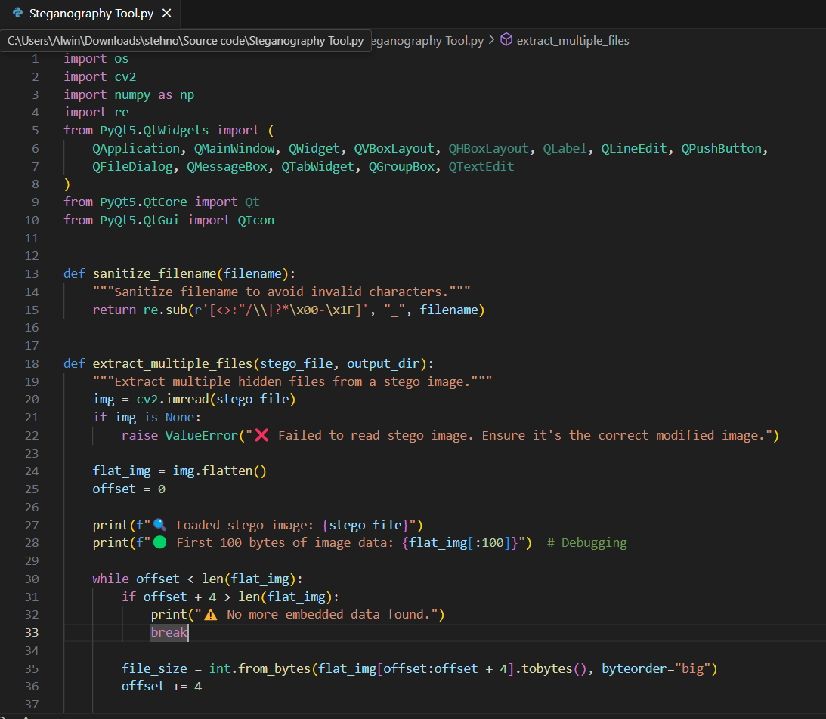
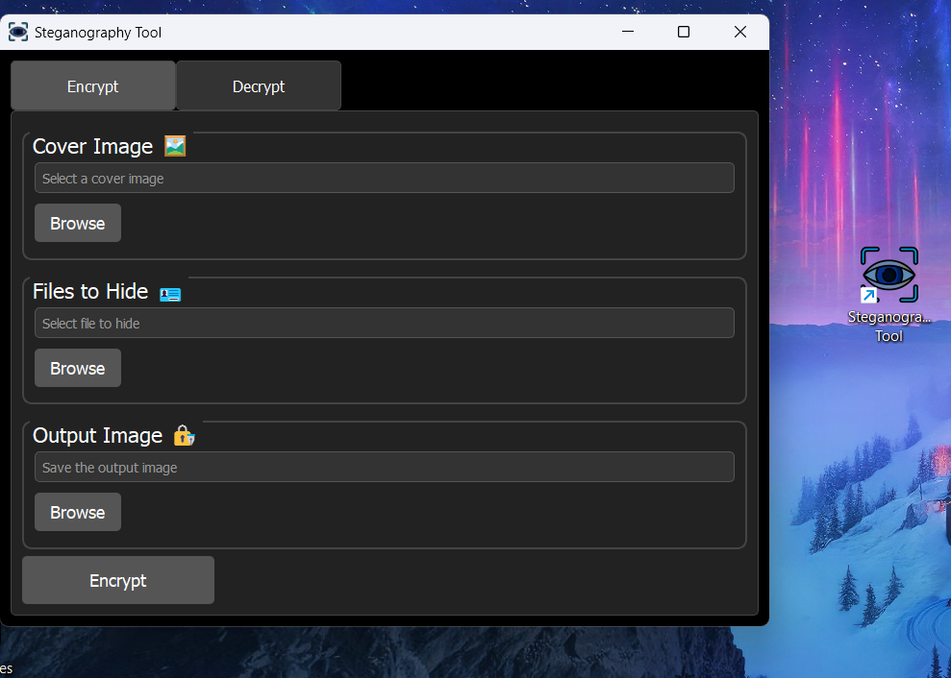
Results

Slide 8
Conclusion
This Image Steganography project provides a simple yet powerful way to hide and retrieve secret messages within images. With features like Drag & Drop Image Selection, Password Protection, and an easy-to-use GUI built with PyQt5, users can securely encrypt and decrypt messages.
This project is useful for privacy-conscious users, cybersecurity enthusiasts, and developers who want to explore steganography techniques..

Slide 9
GitHub Link
Project Repository
GitHub:https://github.com/alwin905/Steganography-Tool.git

Slide 10
THANK YOU

